Slide 1
MoDE Study
Animation

Slide 2
Types
Hand-drawn animation
Stop-Action and Claymation
Computer Animation

Slide 3
Hand-drawn
Sketched by hand
Early examples: Cave drawings, Egyptian funeral paintings, Greek bas-relief
Earthen bowl, over 5000 years old (Iran)

Slide 4
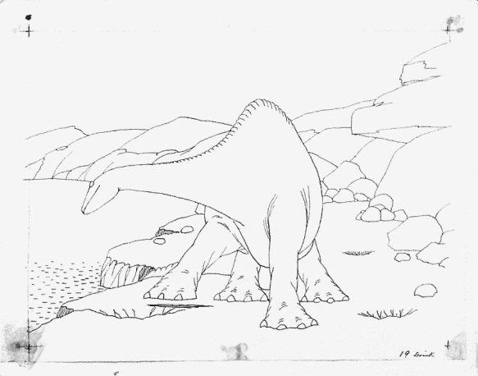
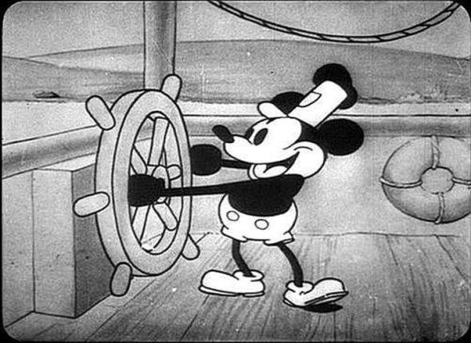
Early Hand-Drawn Animation
Gertie the Dinosaur (1914)
Flashdrive
ONLINE: https://www.youtube.com/watch?v=-_c15oS5i5I
Watch about 2 minutes
Steamboat Willie (1928)
Flashdrive
ONLINE: https://www.youtube.com/watch?v=BBgghnQF6E4
Watch about 5 minutes

Slide 5
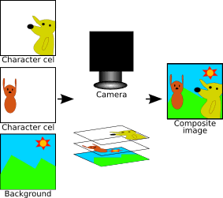
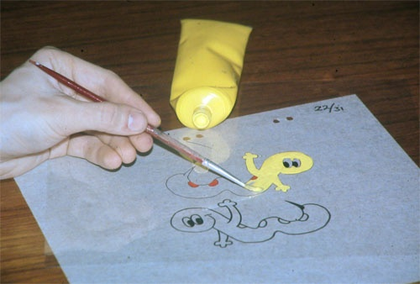
Hand-drawn Innovation:
Cel Animation
Clear plastic sheets are placed over hand-drawn images and colored in
Advantages involve depth and background; single images can be layered over a background, which can be used multiple times

Slide 6
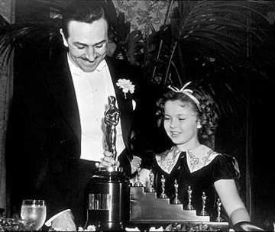
Snow White and The
Seven Dwarfs (1937)
First full-length cel-animated motion picture
First feature-length animated film released in US
Also the first in color
Estimated production cost of $250,000
Actual: nearly $1.5 million
Before release, nicknamed “Disney’s Folly”
By May 1939, international gross of $6.5 million
Watch movie clips from Snow White (DVD), then “making of” Disney cartoons (flashdrive—2.14 to 4.58)

Slide 7
Stop MOtion/Claymation
Technique that involves the stopping and starting of the camera to adjust the position of objects to make them appear as though they are moving fluently
Stop Motion:
Classic: Orange sings Carmen for Sesame Street:
FLASHDRIVE
ONLINE: http://www.youtube.com/watch?v=Z8TqOTe3ODc
King Kong: Skull Island clip
FLASHDRIVE
Making of King Kong clip:
To 1:48 to 4. 29
See teacher page for clip

Slide 8
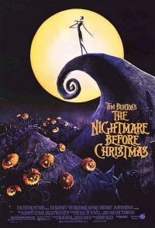
Stop Motion
Nightmare Before Christmas (1993)
Clip 1: opening sequence
FLASHDRIVE
ONLINE: https://www.youtube.com/watch?v=7rUEnIczfG8
MAKING OF CLIPS
Clip 2: 4:15 to 5:30
FLASHDRIVE
Clip 3: 1.58 to 2:50
4:33-6:40
FLASHDRIVE

Slide 9
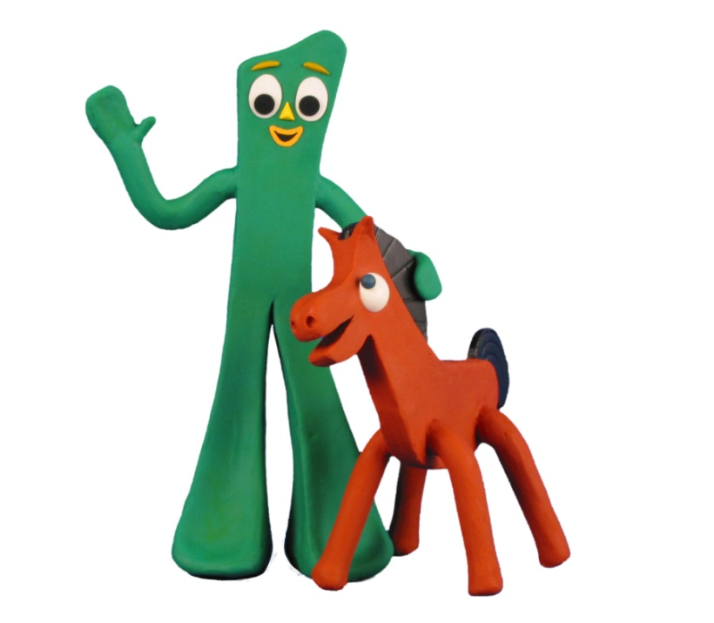
Claymation
Uses plasticine and armatures for figure structures
Small movements are made and filmed to create the illusion of consistent motion
Popularized by Gumby
FLASHDRIVE
ONLINE:
http://www.youtube.com/watch?v=y09hVzHmSus
Watch about two and half minutes

Slide 10
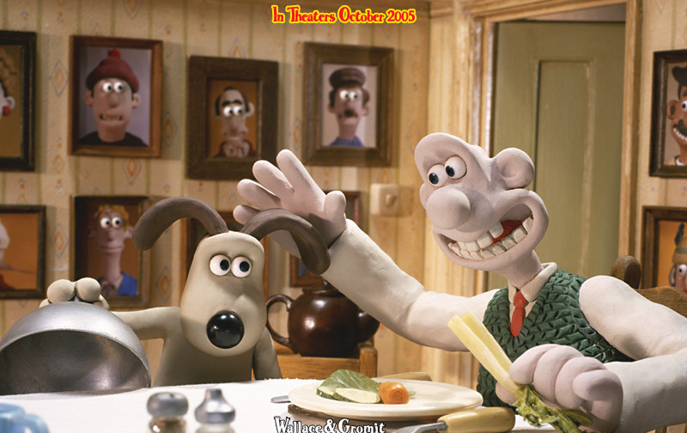
Wallace and Gromit
The Wrong Trousers
FLASHDRIVE
ONLINE:
http://www.youtube.com/watch?v=mk6zbY8i4_8

Slide 11
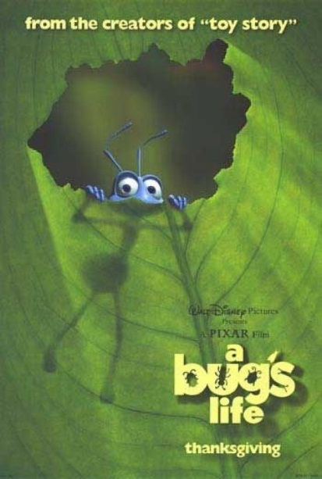
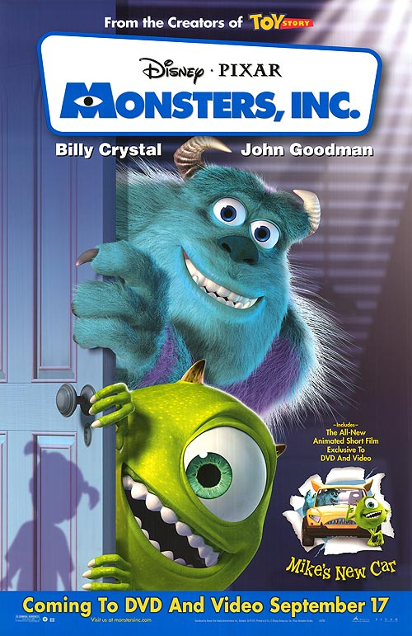
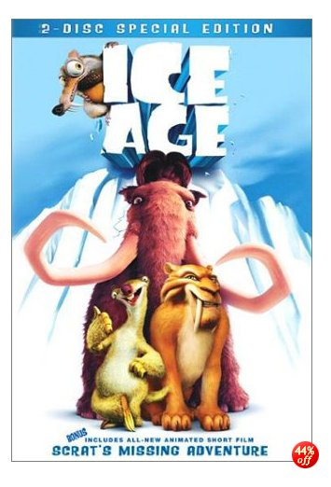
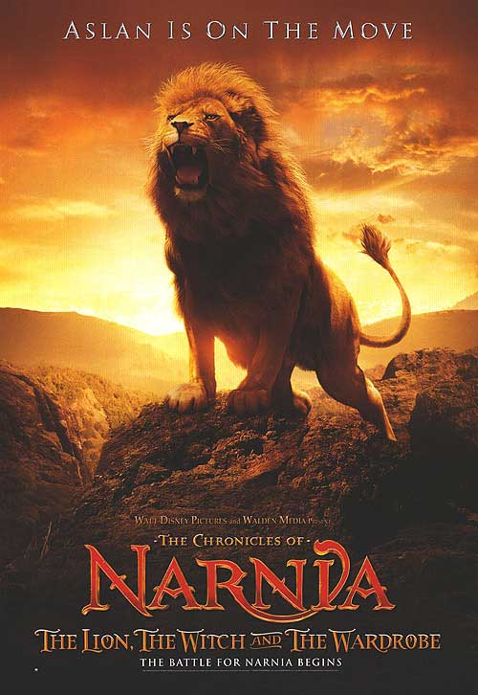
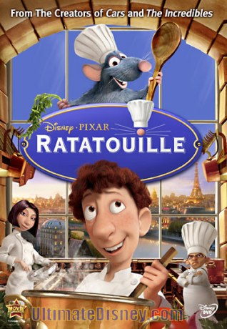
Computer Animation
Computer enhances hand-drawn imagers in 2D and 3D ways
First fully computer-animated film:
Toy Story (1995)
Other Examples:
A Bug’s Life (1998),
Monsters, Inc. (2001)
Ice Age (2002)
Aslan in The Lion, the Witch, and the Wardrobe (2005)
Ratatouille (2007)

Slide 12
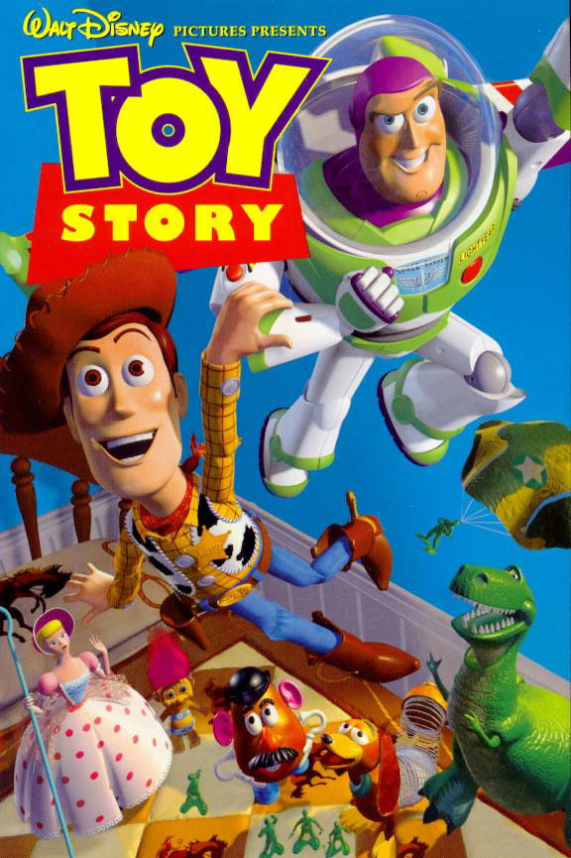
Toy Story (1995)
Process Overview
27 animators
400 computer models
Characters first created out of clay or modeled from a computer diagram
Woody was the most complex
To sync voices with characters: 1 week per 8 second frame
Total:
800,000 machine hours
114,240 frames of animation
2-15 hours per frame

Slide 13
Toy Story screening notes
First, read the article on my teacher page about how Toy Story changed animation. Note that the article talks about the innovation AND the strength of the story. That’s what you’ll track as you screen.
Innovation in the film | Strong story elements (plot, character, conflict, mood, etc.

Slide 14
Toy Story-log response
The online article discussed how the film was innovative but not at the cost of a strong story. Do you think that innovation was evident in the film? Or were strong story elements most prevalent? Or was there a balance? Use specifics to justify your answer.

Slide 15
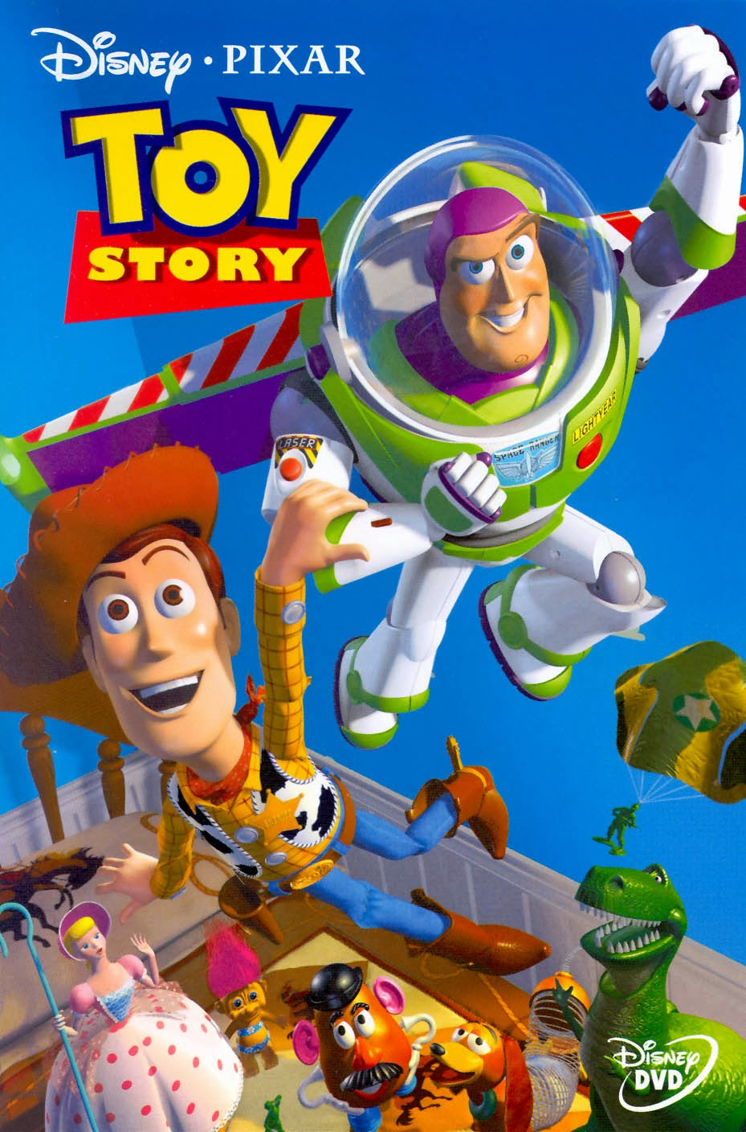
Watch movie clips—beginning of DVD 11.37 to 31.03
Watch “Making of” video on FLASHDRIVE
ONLINE: https://www.youtube.com/watch?v=xnhp7GVEygU
.35 to 1.22 (army men)
2.17 to 4.15
5.20 to 8.25

Slide 16
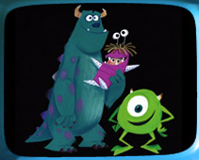
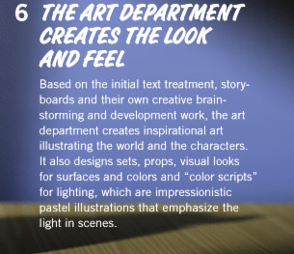
Process Continued
http://www.pixar.com/featurefilms/ts/behind.html
The Making of…
Monsters, Inc.

Slide 17
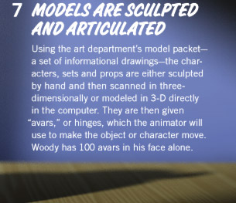
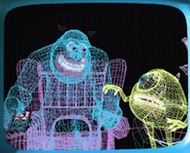

Slide 18
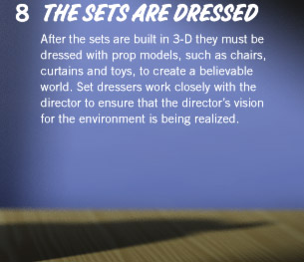
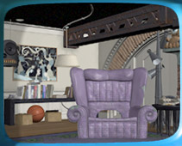

Slide 19
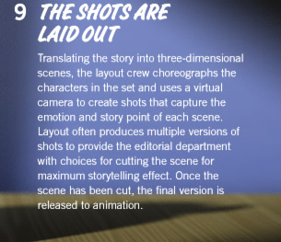
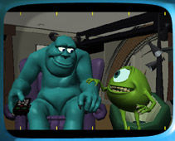

Slide 20
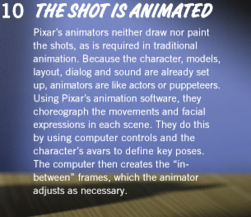
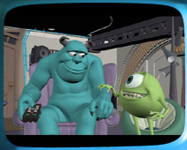

Slide 21
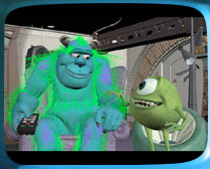

Slide 22
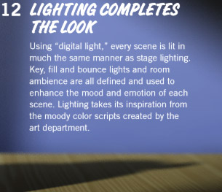
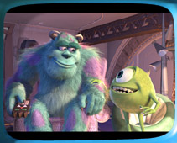

Slide 23
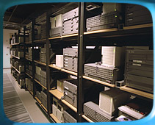

Slide 24
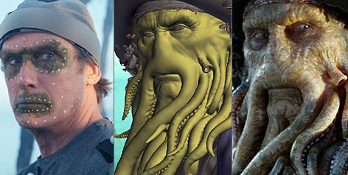
Computer Generated Variation: Motion Capture
Golum in The Lord of the Rings
Davy Jones in
Pirates of the Caribbean

Slide 25
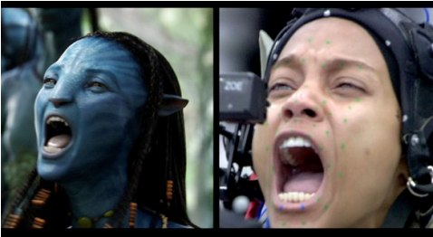
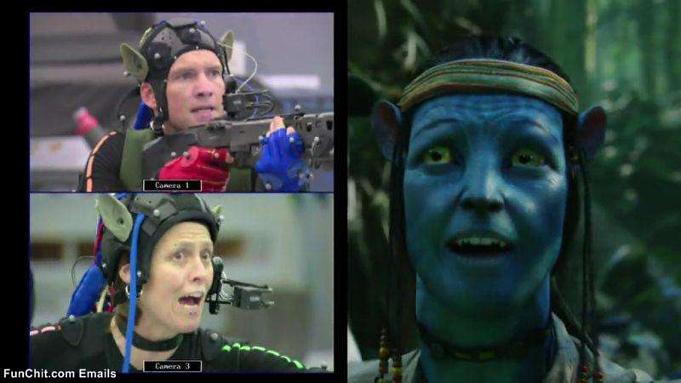
Motion Capture
Live actors wear specialized suits so that computers can copy their movements into computer-generated characters
Avatar

Slide 26
View:
Making of Planet of the Apes
3.17 to 6.15
https://www.youtube.com/watch?v=YNUCxYtWFlg

Slide 27
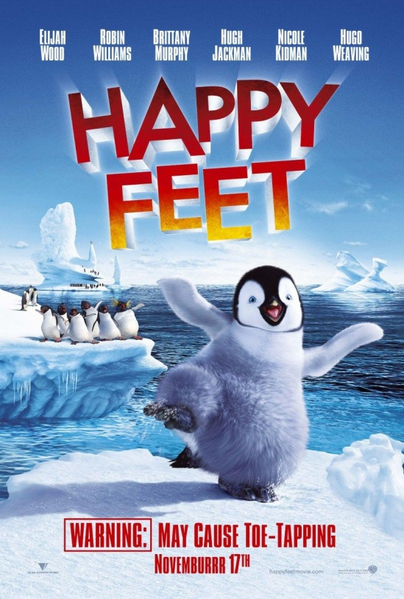
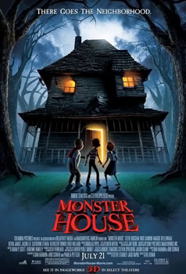
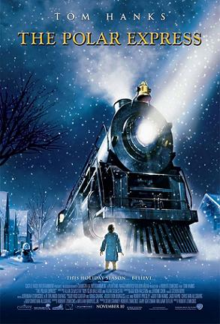
Motion Capture Animation Film Examples:
The Polar Express (2004)
Monster House (2006)
Happy Feet (2006)
A Christmas Carol (2009)

Slide 28
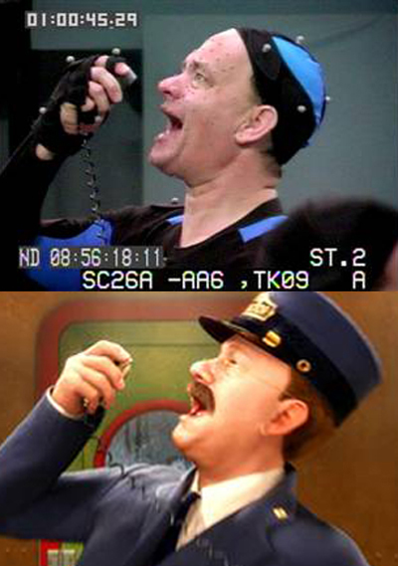
The Polar Express
See “Making of”
On flashdrive
ONLINE:
https://www.youtube.com/watch?v=15U69tCv3eI

